Slide 1
Database Management System
Group members:
Team Member 1:KRUPA K(USN:4NM19CS097)
Team Member 2:JAI KUMAR(USN:4NM19CS081)
Class: 5th SEM CSE B Section
Course Code: 19CS056
Submitted To:
Ms. Ankita A Nayak Assistant Professor Gd-II
Department of Computer Science
and Engineering

Slide 2
STADIUM TICKET BOOKING

Slide 3
Abstract:
The aim of this mini project was to create a reliable and easy to use online ticket booking system.
The major goals of the project were to:
• Create a system which makes it easier for customers to purchase the tickets that they want online.
• To create a more efficient and modern system for providing entry to the ground on a match day. • To provide a fairer system for distributing tickets.
Unfortunately, the current ticket management system leads to misplacement of fees payment details, and late release of reports and insecurity to records. This project is equally aimed at computerizing all the ticket booking activities and generating reports for management decision making. In order to achieve this goal, a thorough System Study and investigation was carried out and data was collected and analyzed about the current system. Secure registration and profile management facilities are provided for the costumers.

Slide 4
Introduction:
This project work was carried out because we believe that there are significant improvements that could be made to the current ticket booking system which would benefit the customers, the fans, who would find it easier to purchase and use their tickets, leading to an altogether more enjoyable match day experience, and, hopefully, more frequent visits to the stadium.
Buying tickets in person is by far the easiest way to purchase tickets, however many fans live outside of the area, or cannot get down to the stadium to purchase tickets in advance due to work.
This results in large queues at the ticket office on a match day. To ease ticket booking task, there is need for a web-based software system which must be created using well established principles of software engineering and latest technologies that guarantee a high degree of reliability and enhance ways of buying elsewhere, hopefully a larger number of people would buy in advance, easing the congestion.
The project has been developed on HTML, CSS, PHP, JAVASCRIPT, BOOTSTRAP AND MYSQL.

Slide 5
OBJECTIVES:
The main objective of the project is to create a reliable and easy to use web-based system which will simplify the ticket booking processes. Other objectives of the work include the following:
• To work towards the elimination of ineffective modes of operation. It centers on the users having a good atmosphere for booking thereby minimizing stress.
• To work towards combating all the problems discovered on the existing system, which are listed under the problems of study.
• Safeguarding of information and ticket fees through effective monitoring.
• Electronic security is maintained as the fans, customers and management are able to login and access the system depending on their privileges.
• The level of accuracy in the proposed system will be higher. All operations would be done correctly and it ensures that whatever ticket sold is from the stadium management team and genuine

Slide 6
SCHEME:
By reducing the need to print and mail tickets, organizers can save huge sums of money on logistics that can in turn be funneled back into the stadium to further enhance the users experience and benefit the attendees as a whole. Additionally the reduction in paper consumed is having a positive environmental impact as well. As consumers and organizers become more conscious of their overall environmental impact, this is likely to be seen as a big factor in the shift from paper to electronic tickets.

Slide 7
METHODOLOGY:
In online ticketing system the customer can buy the tickets directly via the internet. There is no intermediary between the service. The and purchases are completed electronically and interactively in real-time. The assignment is basically done by allowing fans to obtain ticket at the stadium’s office based on the match i.e., the amount paid by fans depend on the seat type and the match.
The ticket booking is a task usually done by the fans and ticket administrator office manually, and this manual system of ticket booking could result to time wasting between the exercises. The development of this system contains the following activities which try to develop online application by keeping the entire process in the view of database integration approach.
The system is a web-based application and will be implemented on a relational database system (MySQL). HTML (hypertext markup language), CSS (cascading style sheet), Java Script and Bootstrap will be used to design the web-user interface, PHP (hypertext pre-processor) will be used as the server- side script language to link the interface and the database.

Slide 8
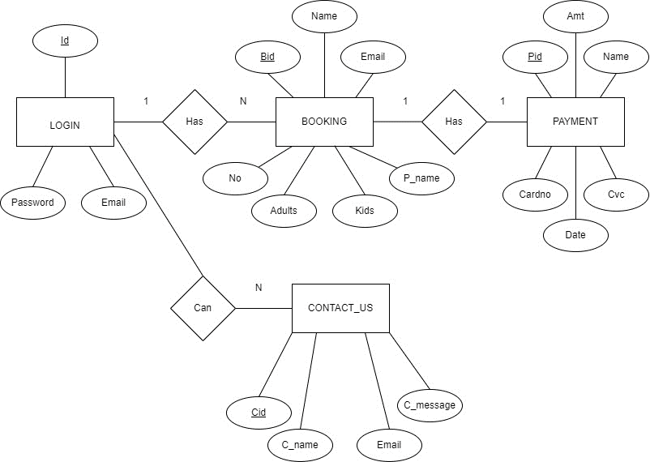
ER-DIAGRAM

Slide 9
OUTPUT:
The Online booking system proved to be the most time saving and quicker alternative to the manual booking system. The user gets to know if he/she has successfully booked his/her ticket according to the seat availability at the time of booking effortlessly.
The website can be accessed 24/7 which also contributes to maximum reservation.
• Simplified operation
• Avoids a lot of manual work
• User friendly interface to enter the data and enquire the database tables
• User can easily access the system without much experience
• Hardware and software security
• Portable and flexible for further extension

Slide 10
PROBLEM STATEMENT:
To simplify the ticket booking processes and drastically reduce the stress involve in ticket booking there is need to designing web-based software that handle all ticket booking activities.

Slide 11
THANKYOU

